Slide 1

Introduction to Processing
Formatting shapes
Produced
by:
Department of Computing and Mathematics

Slide 2
Topics list
Formatting the display window.
Filling shapes with colour.
Formatting the shape outline.

Slide 3
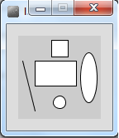
Formatting the display window
Our display window is looking fairly cramped.
The default size of your display window is 100x100 pixels, which is quite small.

Slide 4
Formatting the display window
We can change the size of the display window by calling the size function.
When you use the size function in static drawings, it has to be the first line of code in your sketchbook.
size(w, h)
w = width of the display window
h = height of the display window

Slide 5
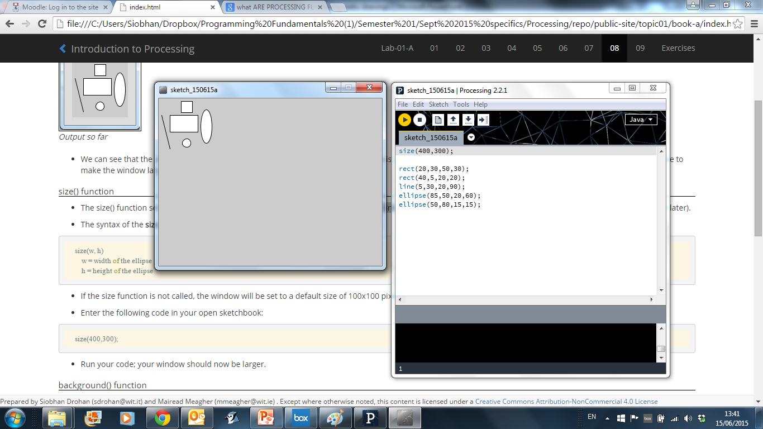
size()

Slide 6
Formatting the display window
Our display window looks less cramped now.
But the default gray colour is not very appealing.
We could use the background function to set the colour to something nicer.

Slide 7
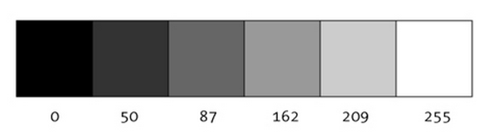
A note on colour first…Grayscale
“0 means black, 255 means white. In between, every other number - 50, 87, 162, 209, and so on - is a shade of gray ranging from black to white.”
https://www.processing.org/tutorials/color/

Slide 8
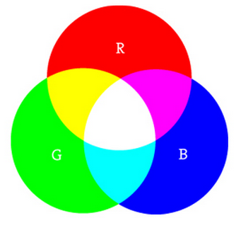
A note on colour first…RGB
“As with grayscale, the individual color elements are expressed as ranges from 0 (none of that color) to 255 (as much as possible), and they are listed in the order R, G, and B.”
Digital colours are made by mixing the three primary colours of light (red, green, and blue).
https://www.processing.org/tutorials/color/

Slide 9
A note on colour first…RGB
“As with grayscale, the individual color elements are expressed as ranges from 0 (none of that color) to 255 (as much as possible), and they are listed in the order R, G, and B.”
Digital colours are made by mixing the three primary colours of light (red, green, and blue).
https://www.processing.org/tutorials/color/

Slide 10
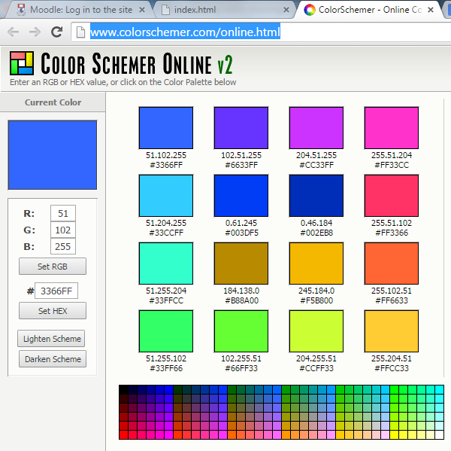
A note on colour first…RGB
http://www.colorschemer.com/online.html

Slide 11
background() - syntax
background(grayscale)
grayscale = grayscale colour (a number between 0 [black] and 255 [white] inclusive)
background(r, g, b)
r = red colour (a number between 0 and 255 inclusive)
g = green colour (a number between 0 and 255 inclusive)
b = blue colour (a number between 0 and 255 inclusive)

Slide 12
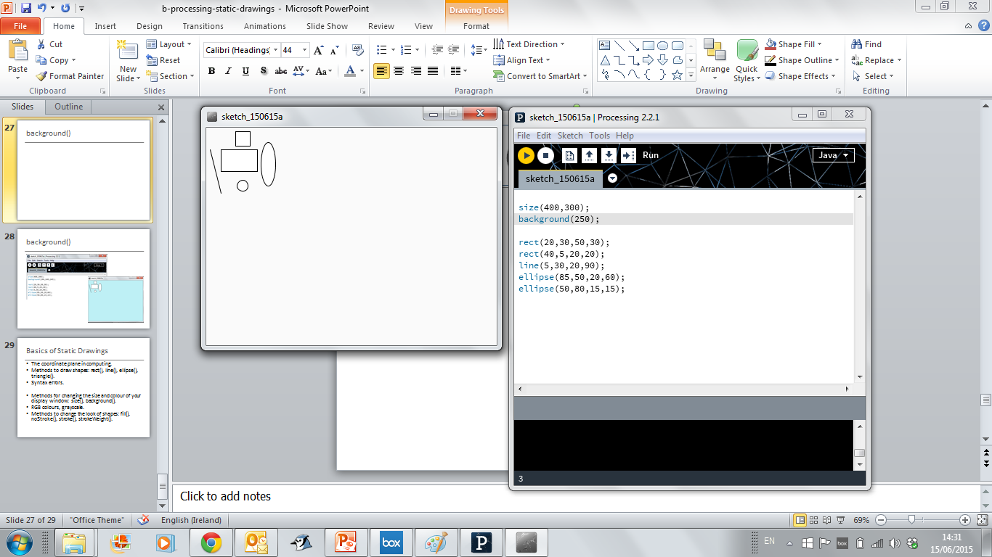
background()

Slide 13
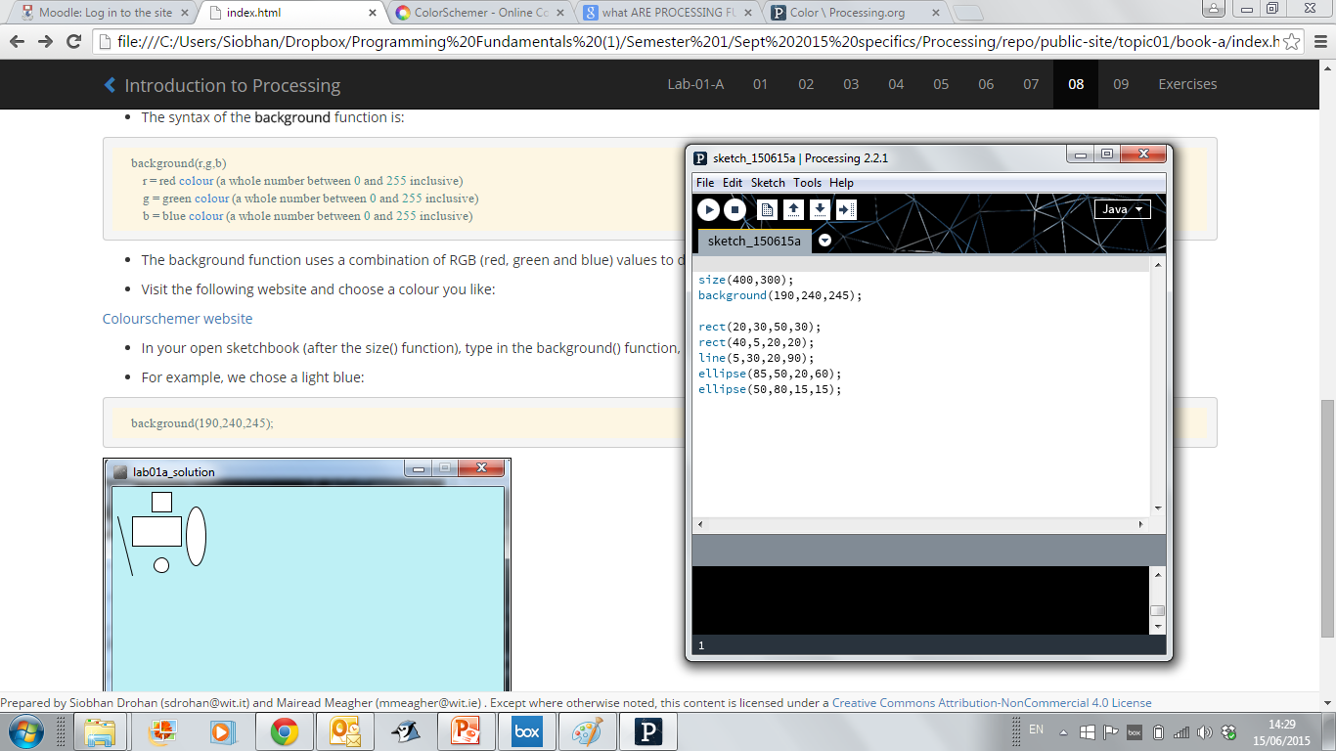
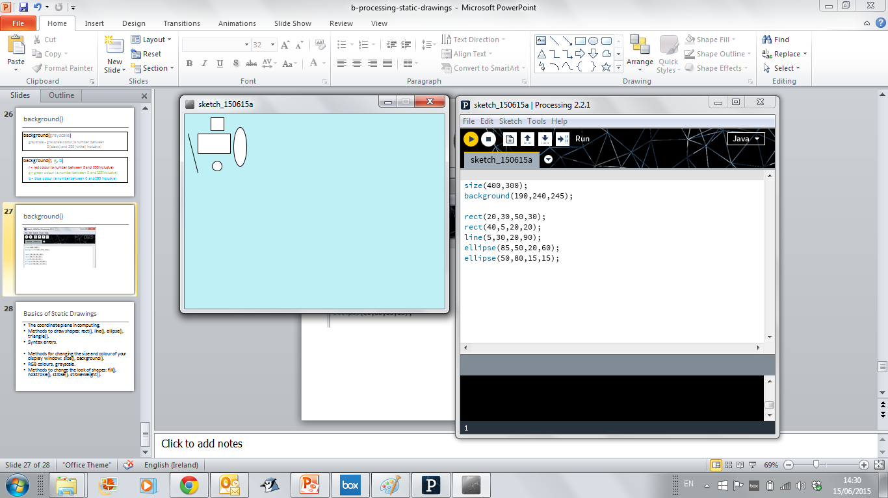
background()

Slide 14
Topics list
Formatting the display window.
Filling shapes with colour.
Formatting the shape outline.

Slide 15
fill() - syntax
fill (r, g, b)
r = red colour (a number between 0 and 255 inclusive)
g = green colour (a number between 0 and 255 inclusive)
b = blue colour (a number between 0 and 255 inclusive)
fills shapes with a chosen colour.
can use the RGB colours to select a colour.
all shapes drawn after the fill function is called, will be filled with the chosen colour.

Slide 16
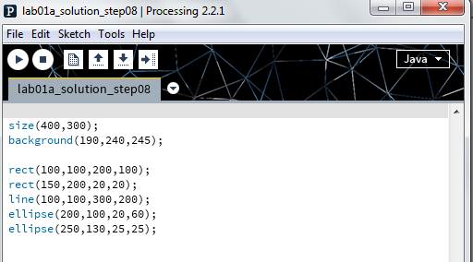
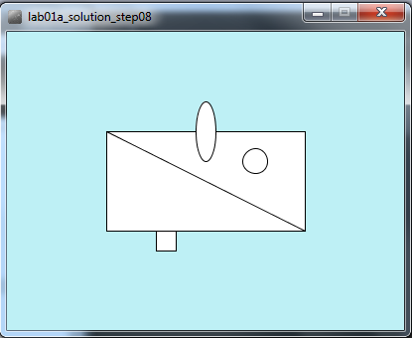
fill()
Starting code…

Slide 17
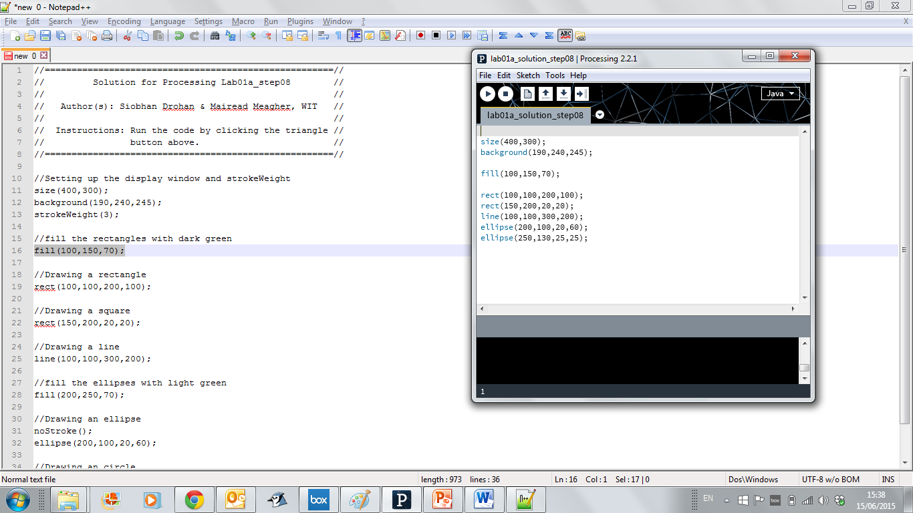
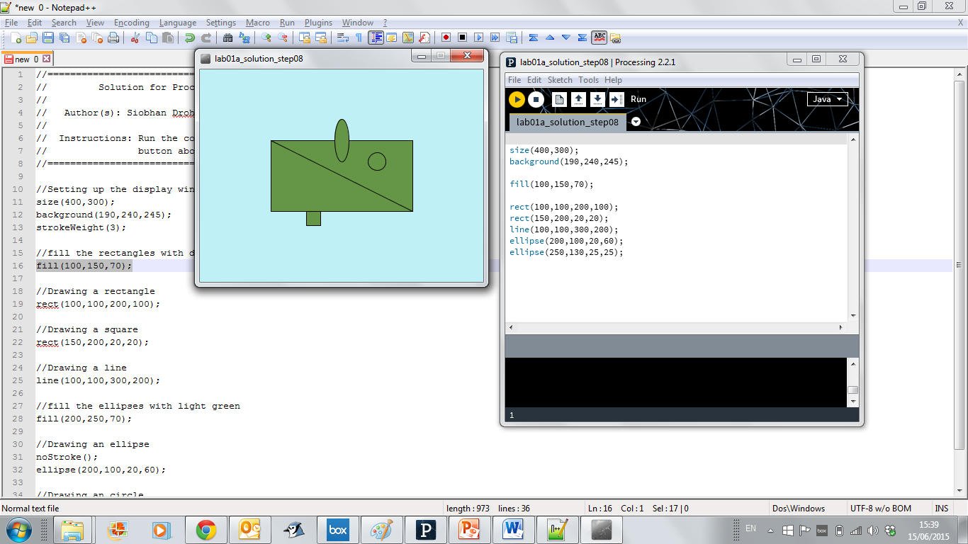
fill()
All shapes filled with dark green…

Slide 18
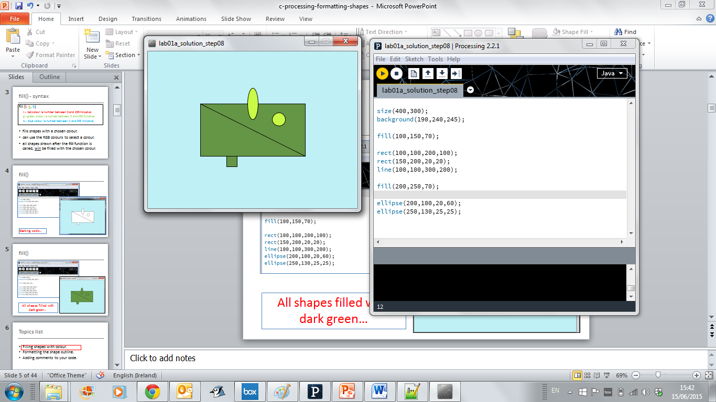
fill()
Rectangles filled with dark green…
Ellipses filled with light green…
Order of statements matter!!!

Slide 19
Topics list
Formatting the display window.
Filling shapes with colour.
Formatting the shape outline.

Slide 20
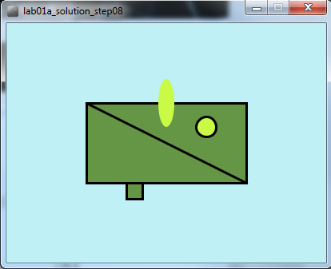
Changing the outline (i.e. stroke)
Before
After (changes):
The oval has no border; all other shapes do.
The outline is heavier.
We will now make those changes

Slide 21
noStroke() - syntax
noStroke();
//no parameters defined for this function.
A stroke is the outline of a shape.
The noStroke() function disables the outline on shapes that are drawn after the function is called.
All shapes drawn after the noStroke function is called, will have no outline.

Slide 22
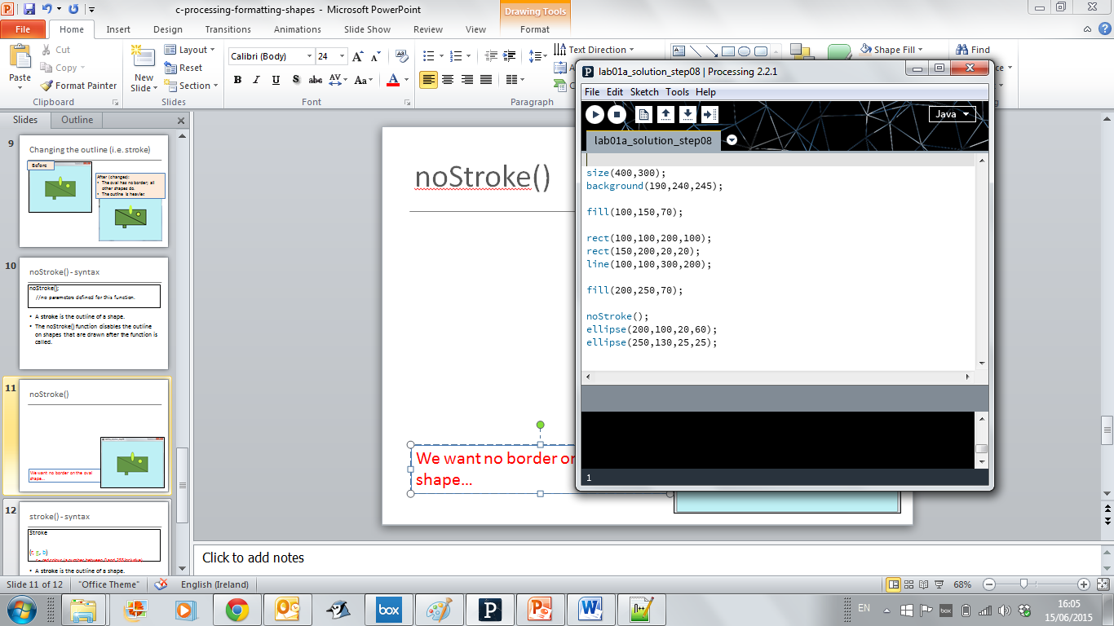
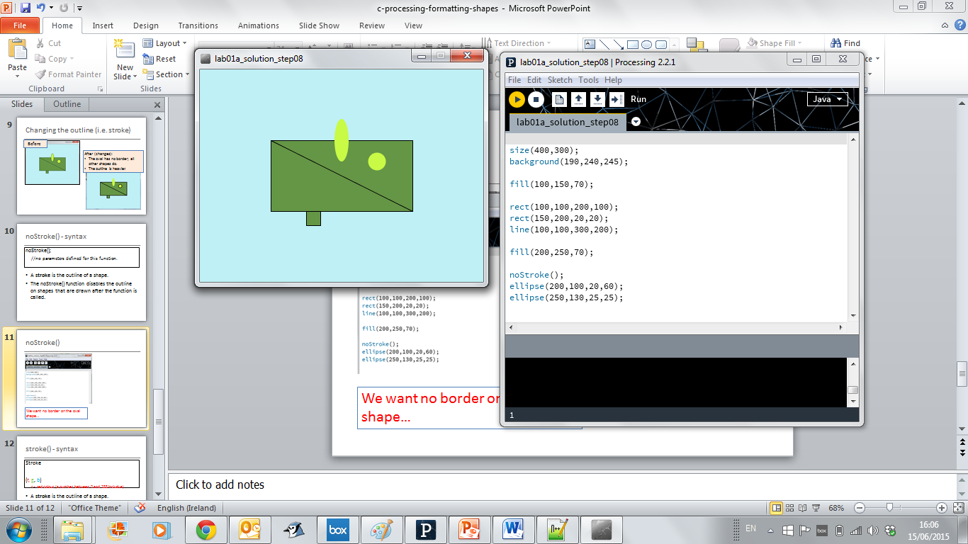
noStroke()
√ We have no border on the oval shape.
X But now our circle also has no border.

Slide 23
stroke() - syntax
stroke (r, g, b)
r = red colour (a number between 0 and 255 inclusive)
g = green colour (a number between 0 and 255 inclusive)
b = blue colour (a number between 0 and 255 inclusive)
The stroke() function enables the outline on all shapes that are drawn after the function is called.
When you call stroke(), you need to specify a colour.

Slide 24
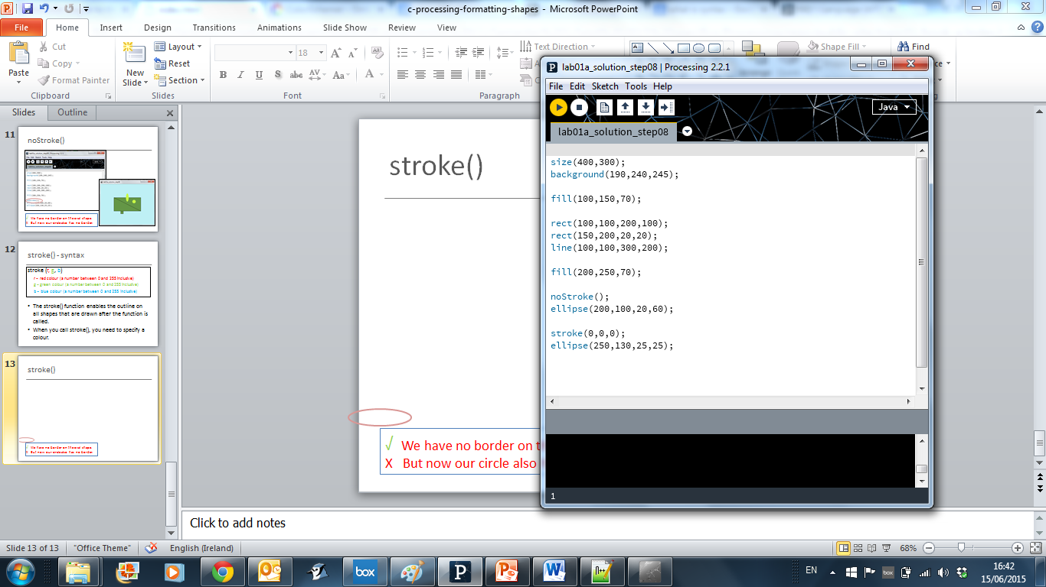
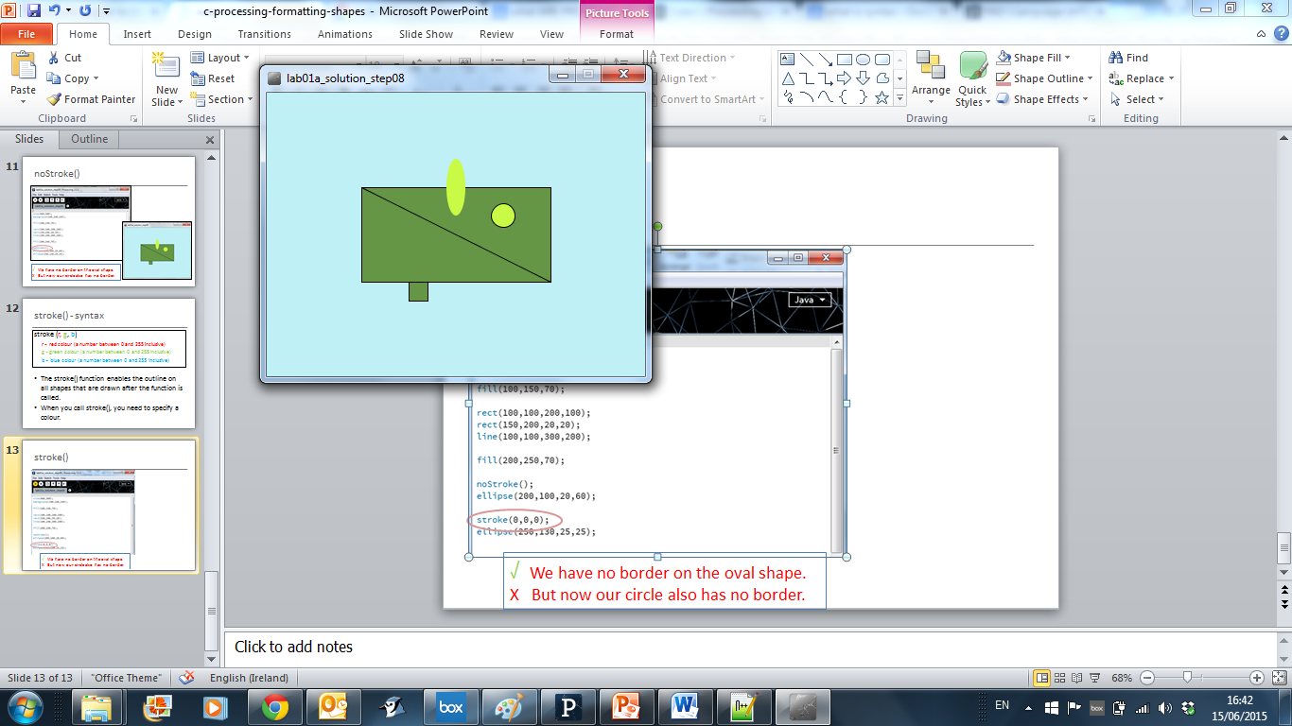
stroke()
√ Our circle now has a border.

Slide 25
strokeWeight() - syntax
strokeWeight (pixels)
pixels = thickness of the outline measures in pixels.
The strokeWeight() function allows you to choose the thickness of a line/outline on shapes.
The chosen thickness will apply to all lines/shapes that are drawn after the function is called.
The thickness is specified in pixels.
The default thickness is 1 pixel.

Slide 26
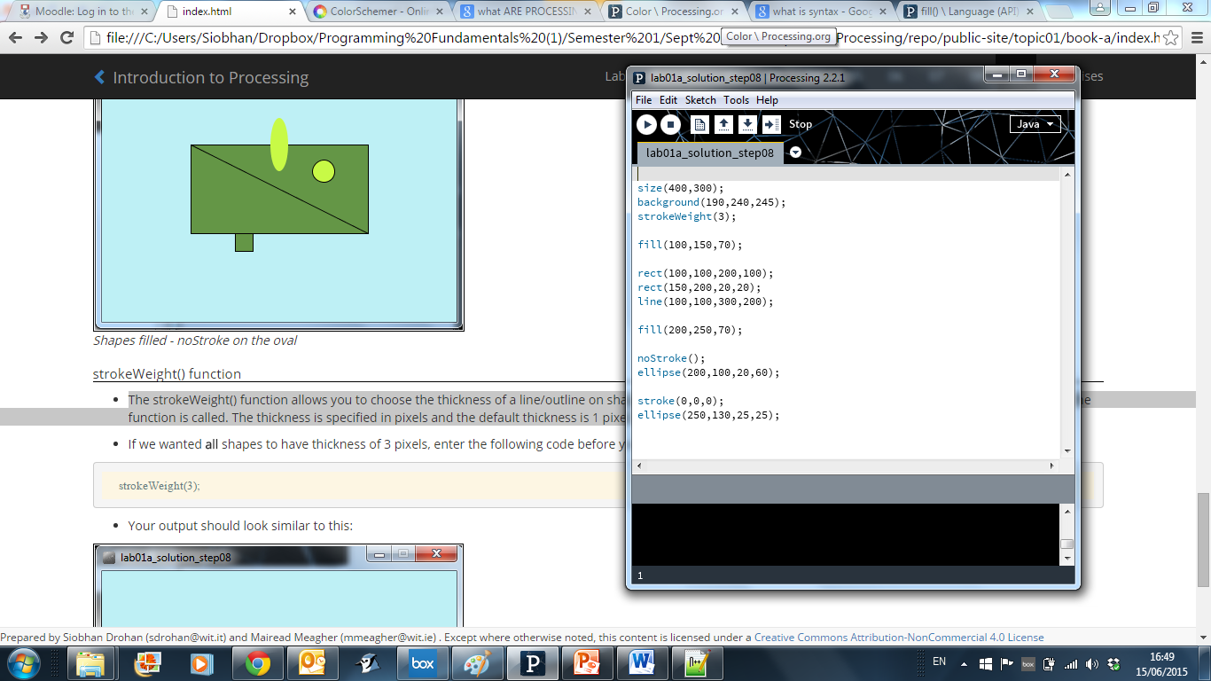
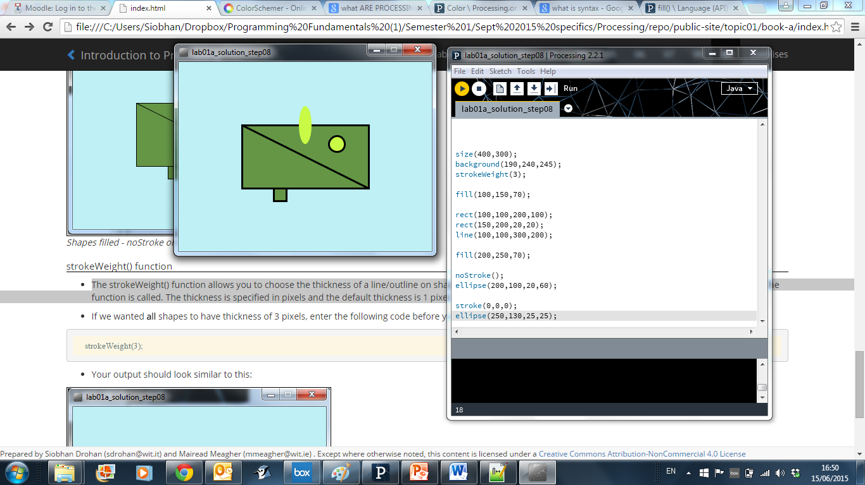
strokeWeight()
√ Our outline is now heavier

Slide 27

Questions?

Slide 28
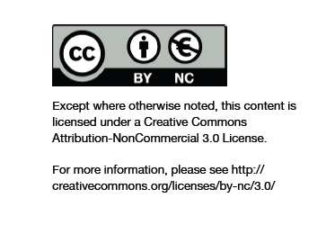
Department of Computing and Mathematics
http://www.wit.ie/

